Slide 1

Quality Assessment

Slide 2

Quality
Assessment
Guide

Slide 3
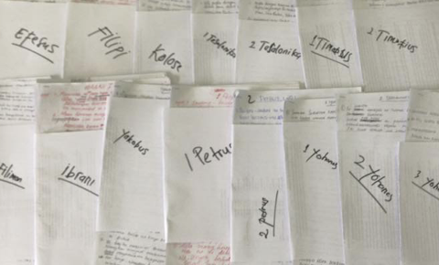






Is it ready?
Keyword Check
Self-edit
Peer-edit
Quality
Naturalness
Standard
Local Church

Slide 4

Globally Accepted Qualities

Slide 5

What makes a good translation?

Slide 6
Try it
Build your guide

Slide 7
Quality Assessment Guide
Qualities
Definitions
Questions
Accurate
Faithful
Historical
Clear
Natural
Correct style
Grammar is correct
Other qualities
________________
________________
________________
________________
________________
________________
________________
________________
________________
________________
________________
________________
________________
________________
________________
________________

Slide 8
Try it
Matthew 1:18–25
How did it go?

